Slide 1

LingShuShiJian
AI-powered Chinese classics(ancient poetry and prose)
intelligent learning platform
Reporting person：WenZiyi

Slide 2
CONTENTS
1
2
3
4
Project Background
and Objectives
Platform function
introduction
Characteristics of
WeChat mini-programs
Development progress
and plan

Slide 3
Project Background
and Objectives
PART ONE

Slide 4

Project Background
Cultural value
Technical pain points
Educational needs
Develop an intelligent learning platform can revitalize Chinese classics in a digital form, enhance cultural identity and soft power.
The existing ancient poetry learning products have a single technology, lack intelligent interaction, and do not provide personalized assistance with AI.
The teaching of traditional ancient poetry is restricted in many ways, and the "double reduction" policy promotes the urgent need for diversified learning tools in society.

Slide 5
Project Objectives
Technical objectives
Develop a platform with efficient search and good interaction, enabling precise retrieval and convenient operation.
User goals
Assist middle and high school students in quickly mastering required vocabulary and improving learning efficiency.
Cultural objectives
Inherit excellent traditional Chinese culture through vocabulary learning and enhance cultural identity.

Slide 6
Platform function
introduction
PART TWO

Slide 7
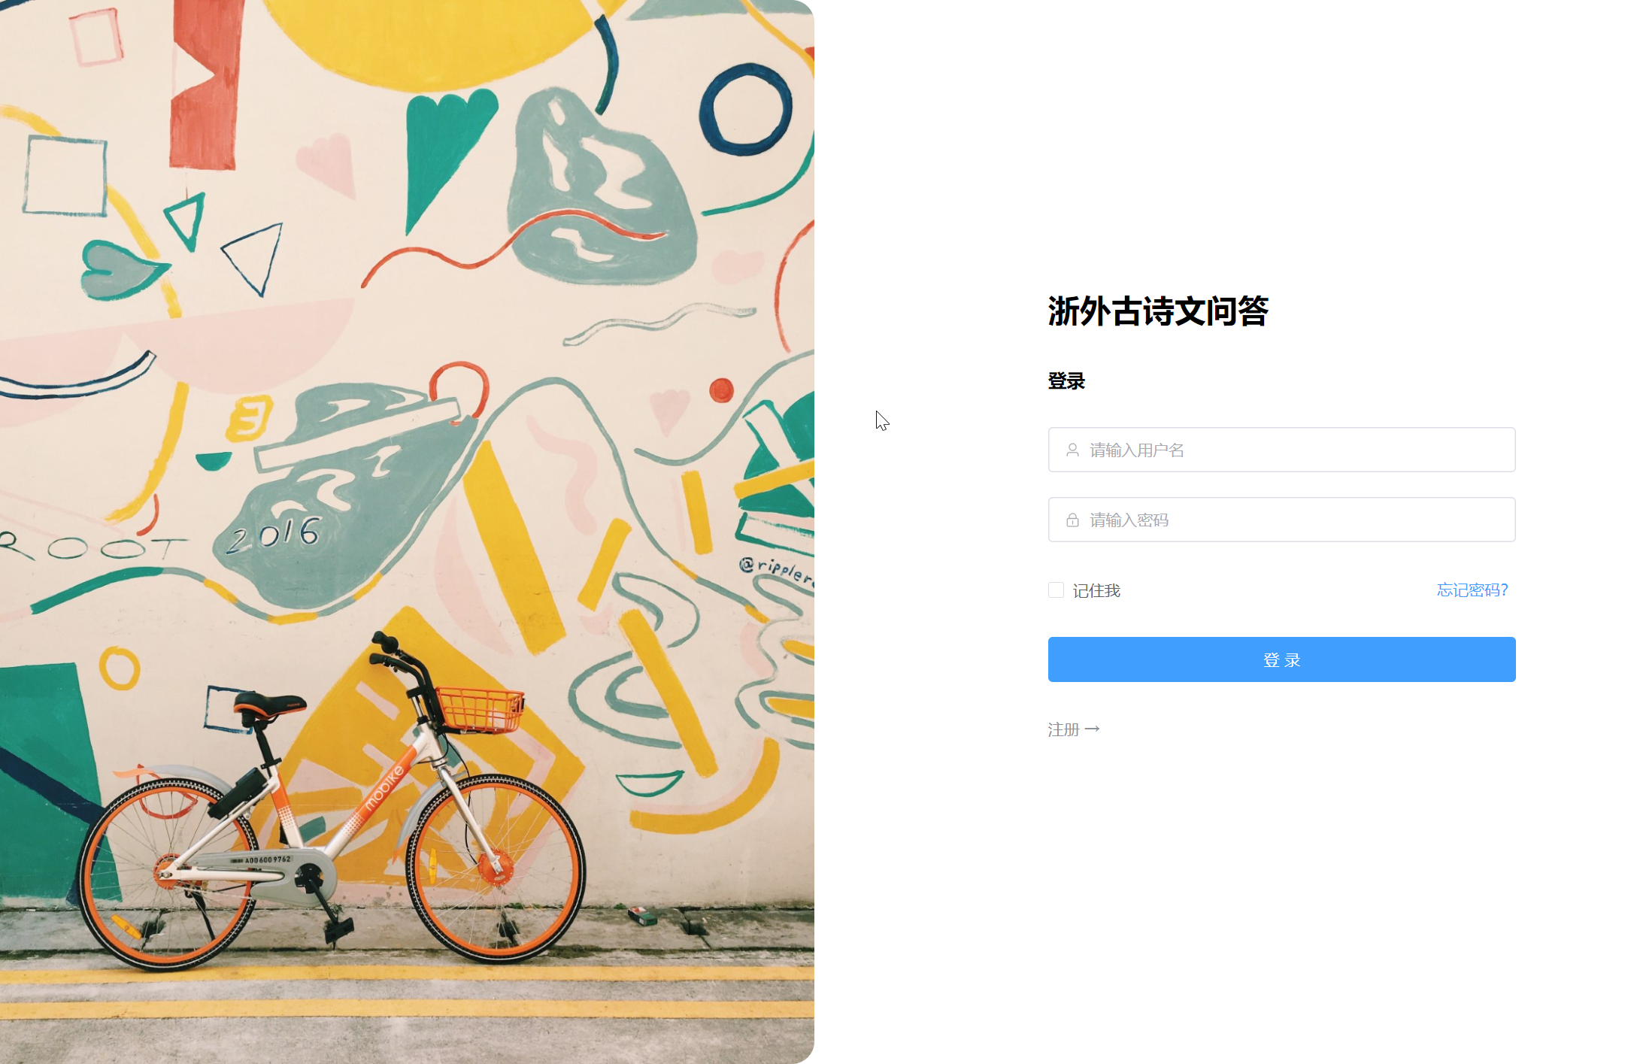
Core functions of the platform
Login registration page
The login registration page currently provides username-password login. For registration, click "register" to enter the page and complete operations.

Slide 8
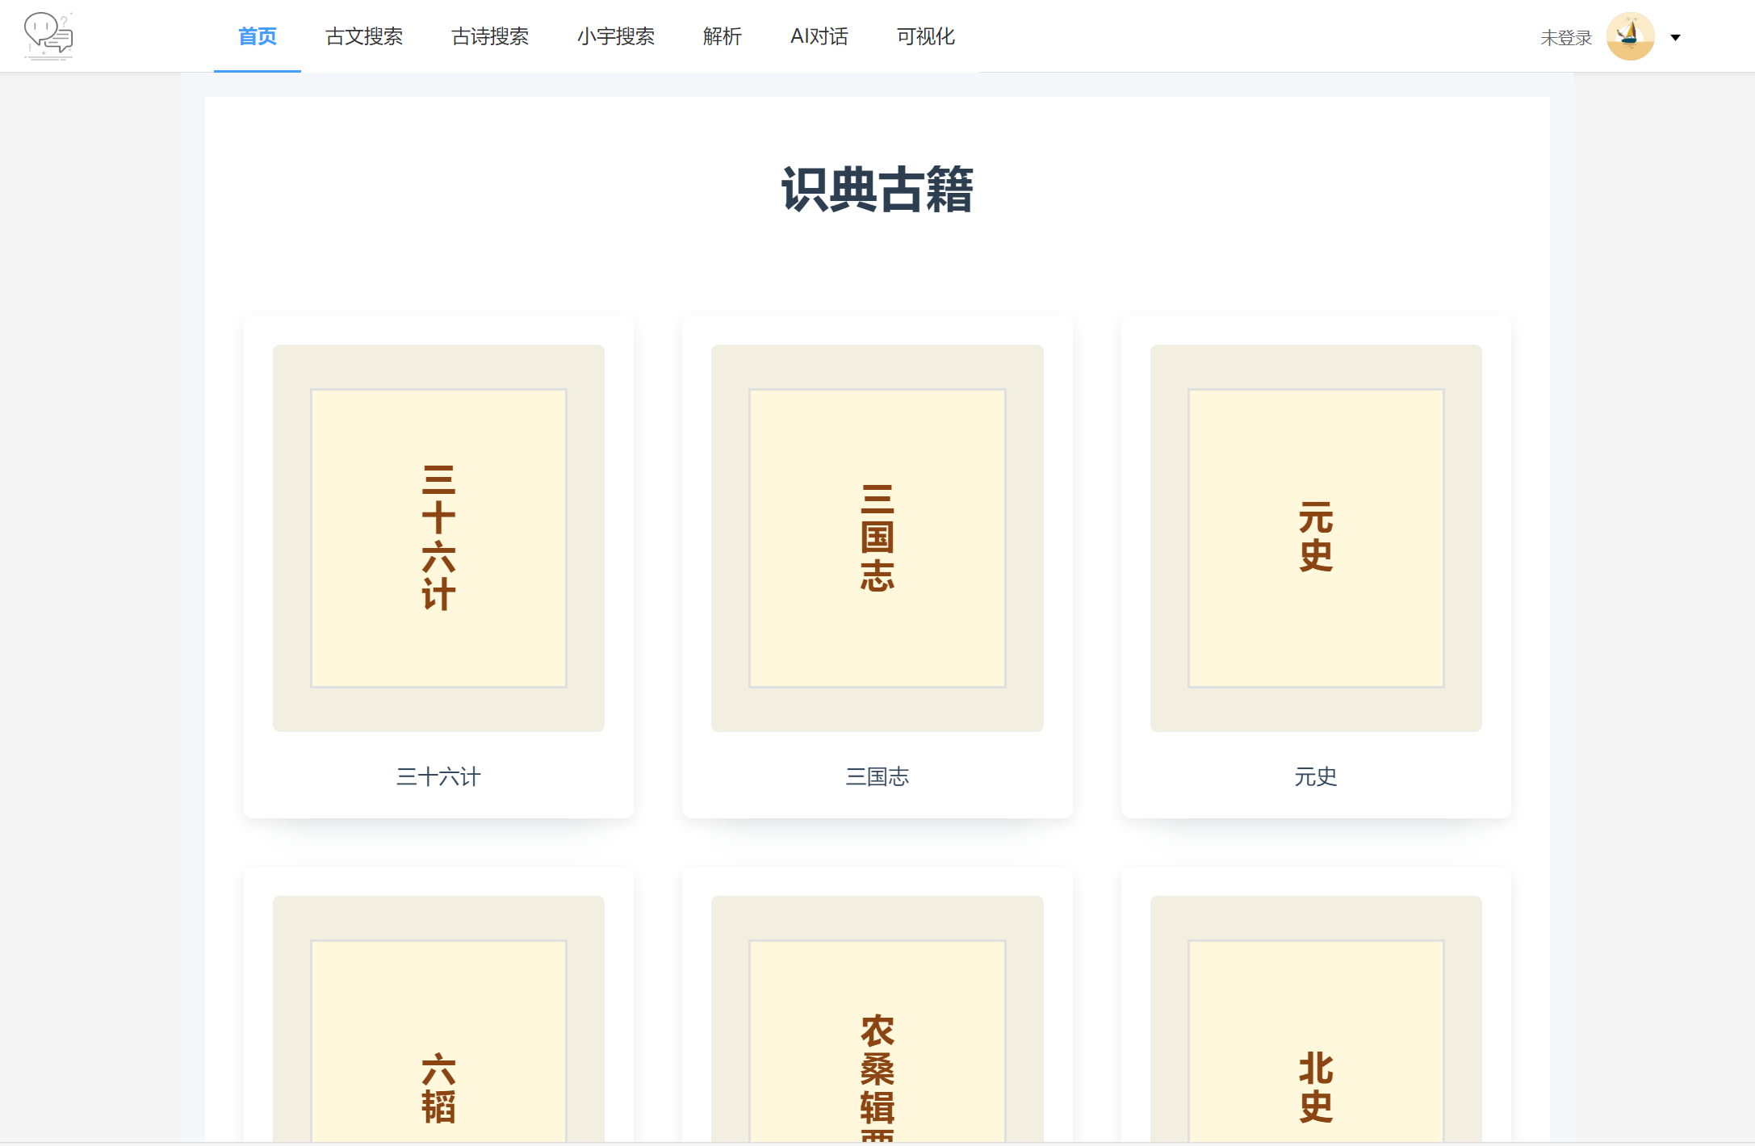
Core functions of the platform
Home page
The home page uses a modular + waterfall design with a top navigation bar. Ancient books enables one-click jumps to relevant pages. The personal center, in the upper-right corner, allows quick access to account settings.

Slide 9
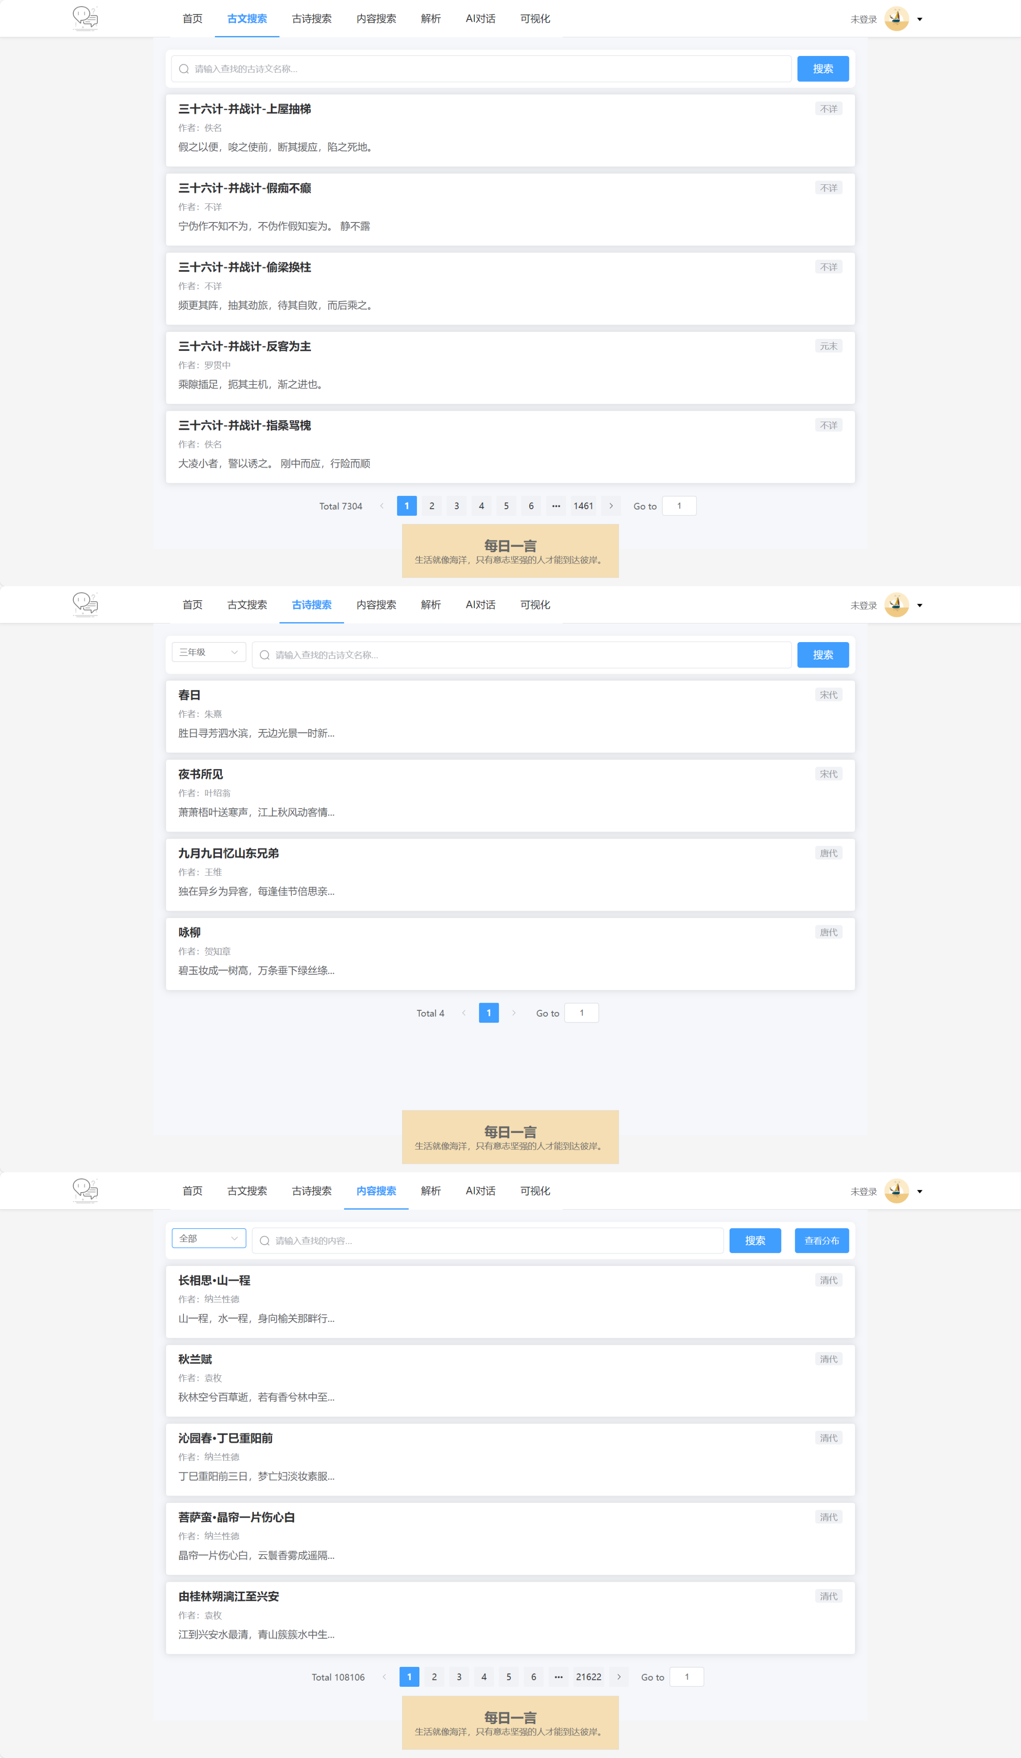
Search page
There is a display area for ancient poetry
content.
The search box is rich in functions, can
be smartly associated, and also has a grade
and dynasty filtering drop-down box.
The "Daily Word" section is set in a fixed
position at the bottom of page.

Slide 10
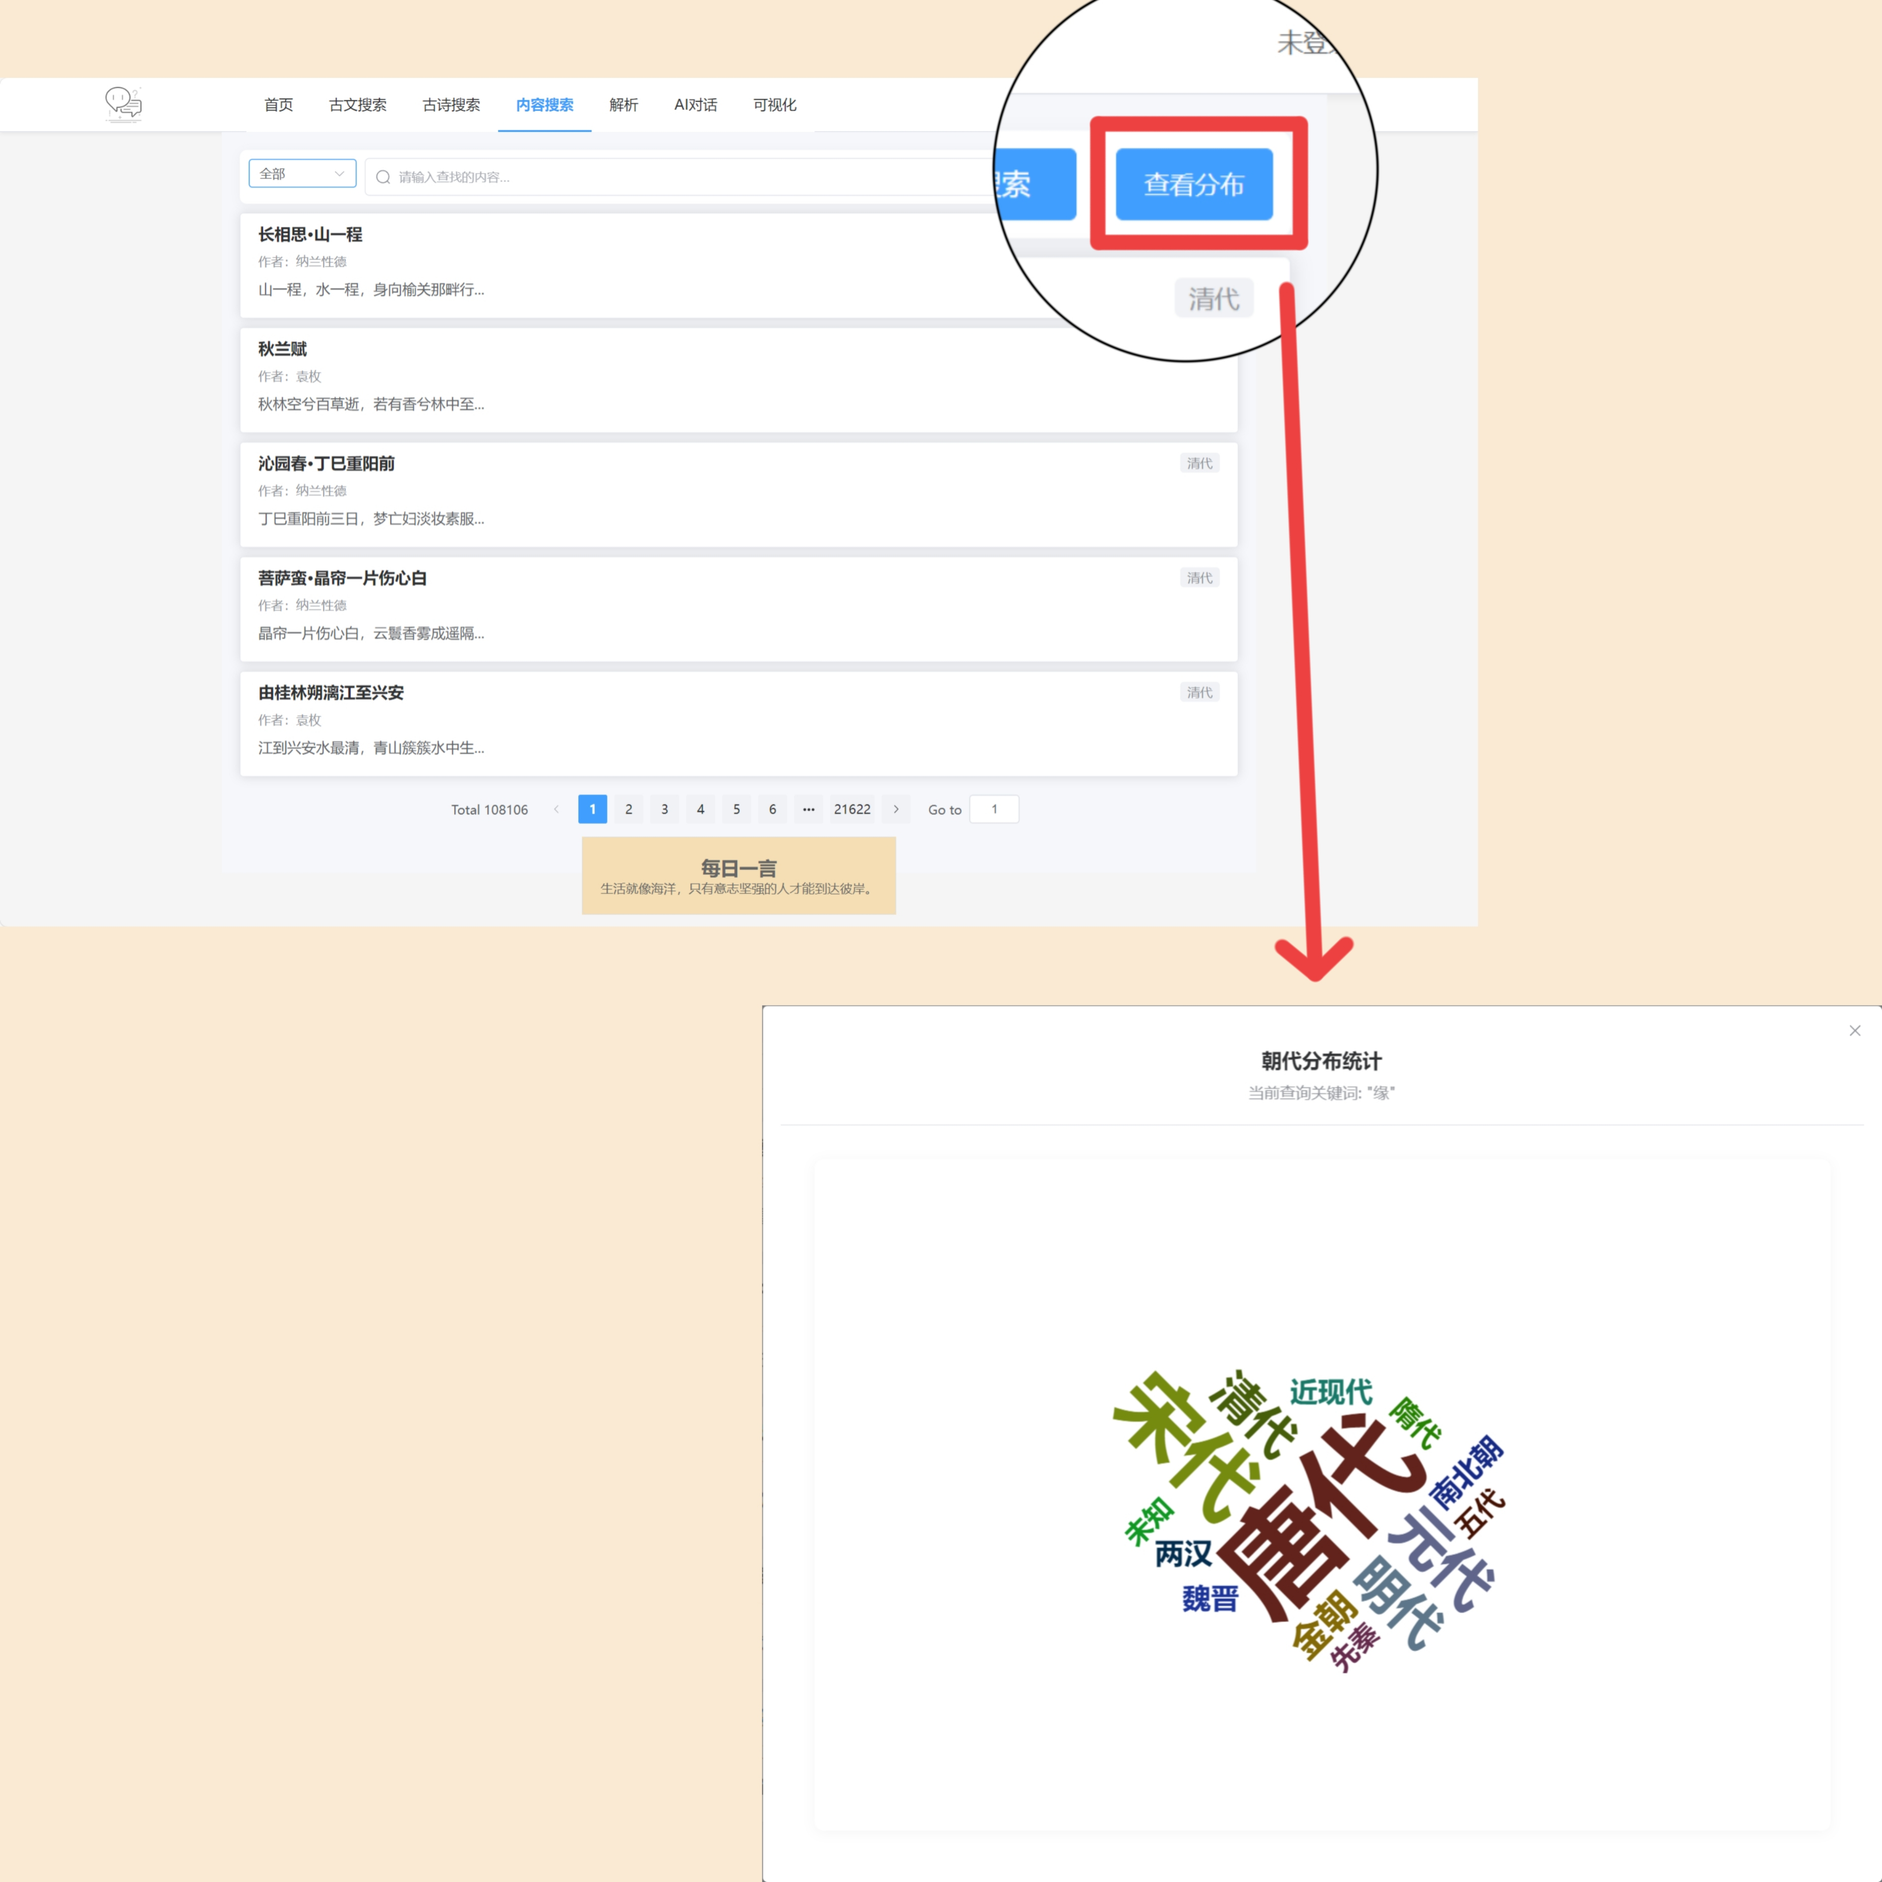
Core functions of the platform
Content search page
On the content search page, enter the keywords and click "View Distribution," and the page can generate a dynamic dynasty word cloud map to visually display the proportion of keywords in ancient poems of different dynasties.

Slide 11
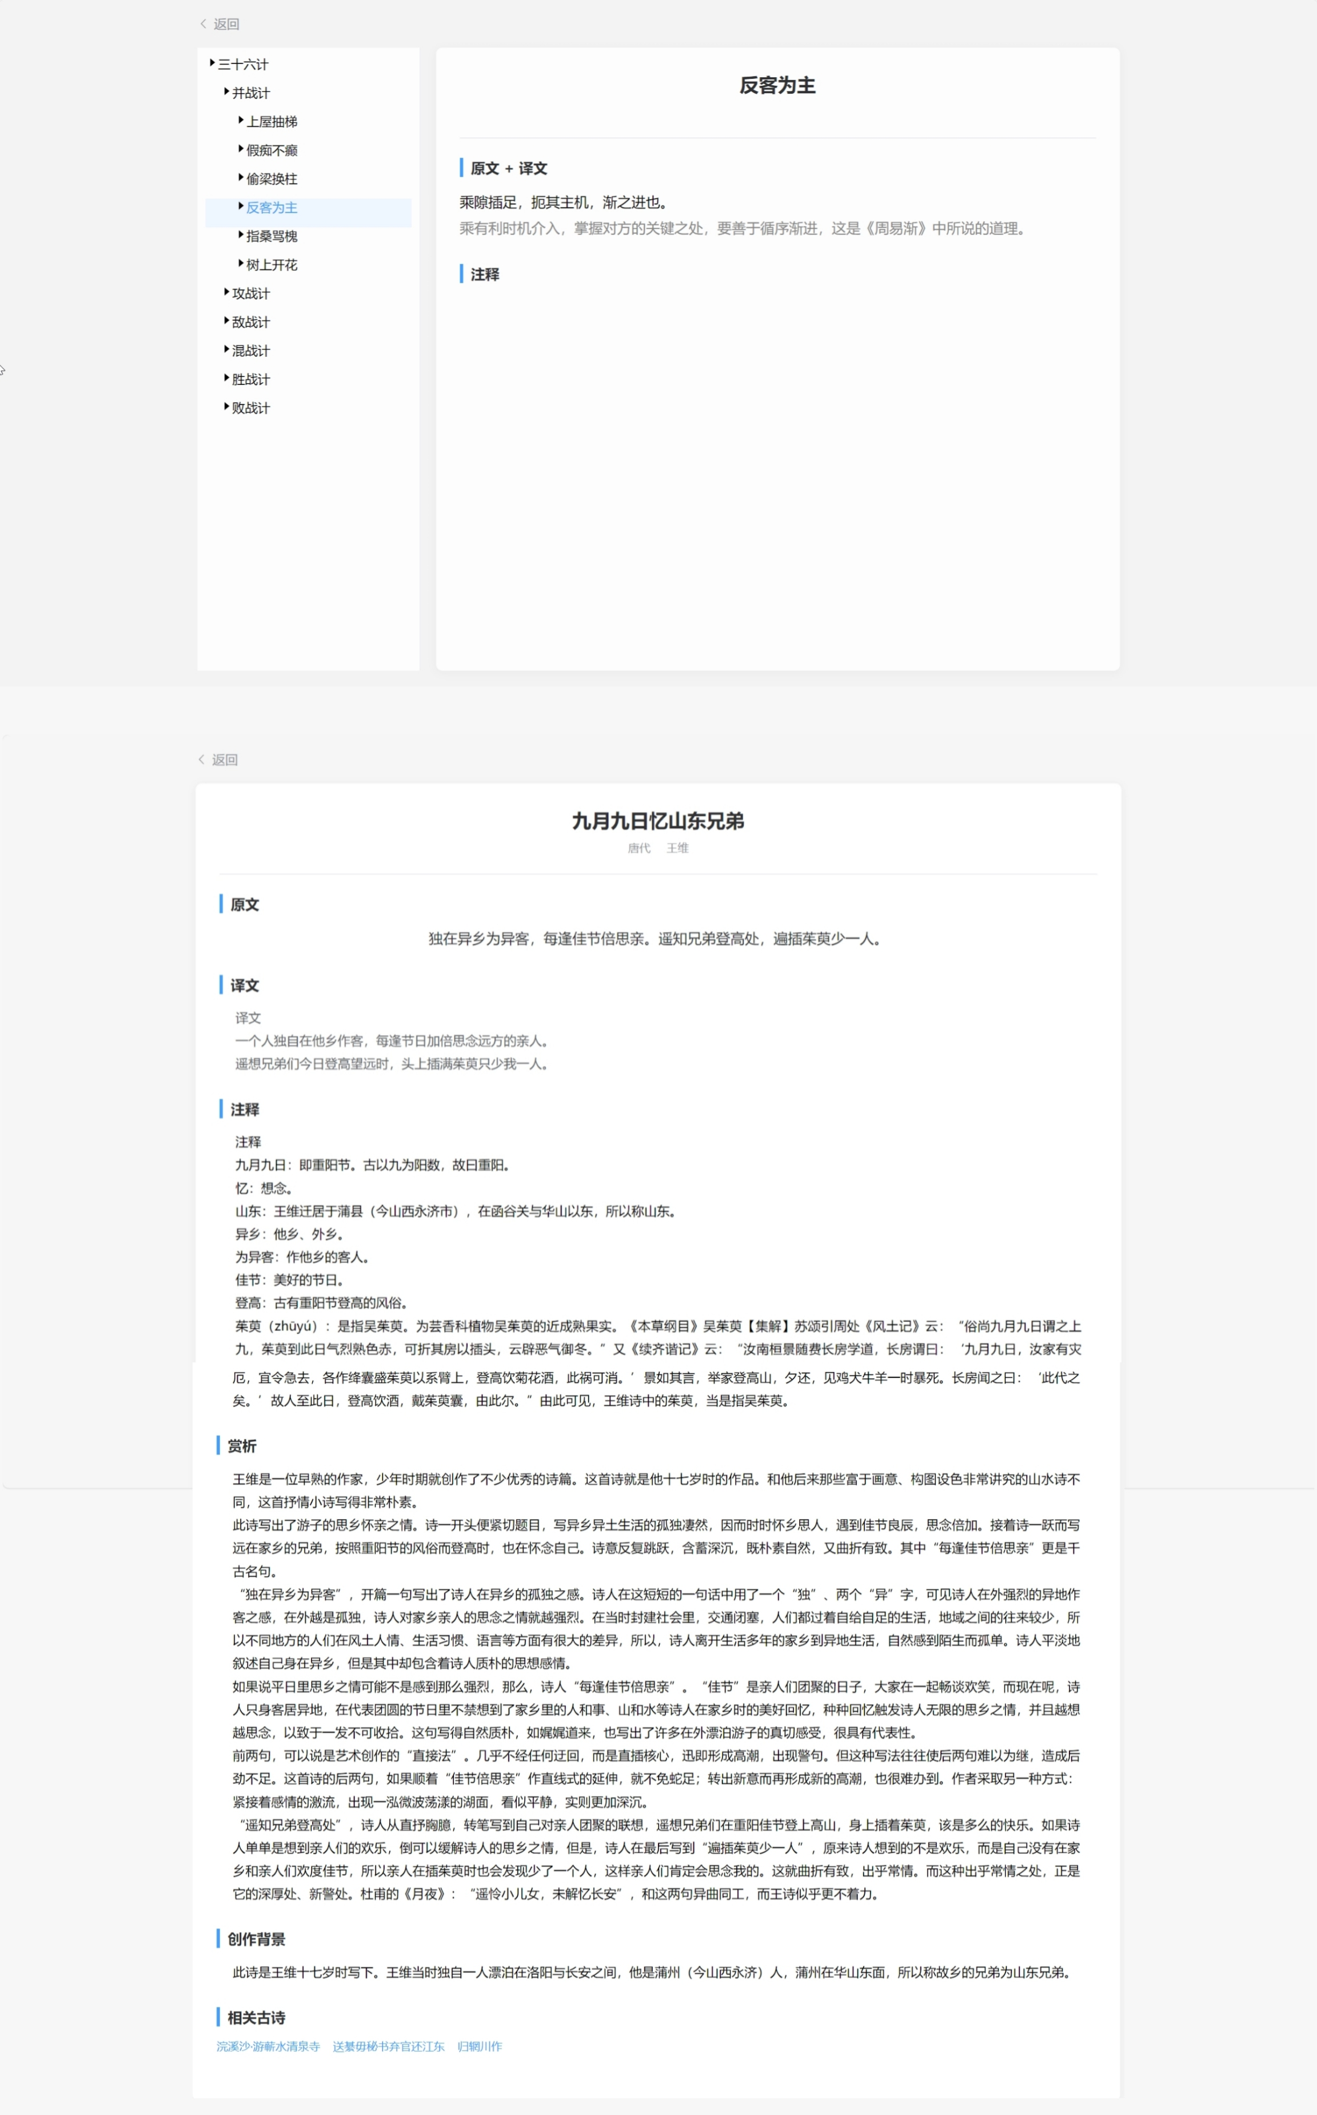
Detailed page
On the left side of the detailed
page of ancient poetry and prose,
a dynamic tree-like directory
structure is set up to show the
classification of ancient poetry
and prose books in a hierarchical
form. Users can click on the title
of any article to view and learn
the one-stop content of the
corresponding article.

Slide 12
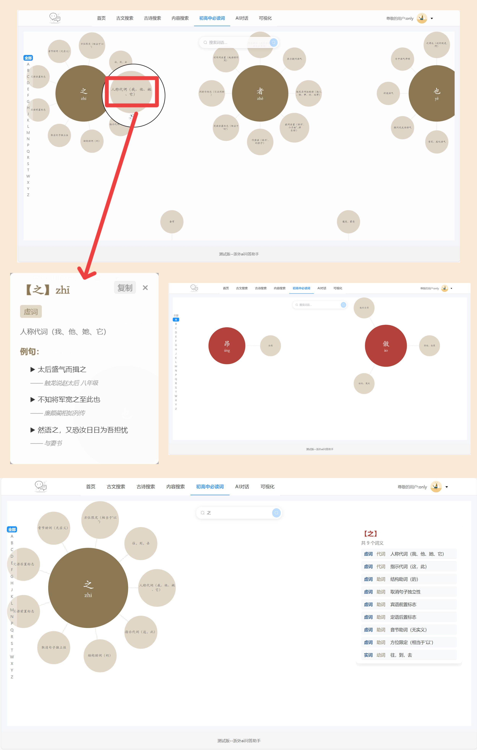
High school and middle school must-read words page
This page visually shows words. It
supports zooming and dragging.
Each word has clickables ball icon;
clicking it pops up a detailed page with
full parts of speech, meanings, examples,
and sources.
There's an "A-Z" alphabetical vocabulary
index on the left for quick word location.
When searching for a single word, a
meaning summary list appears on the right.

Slide 13
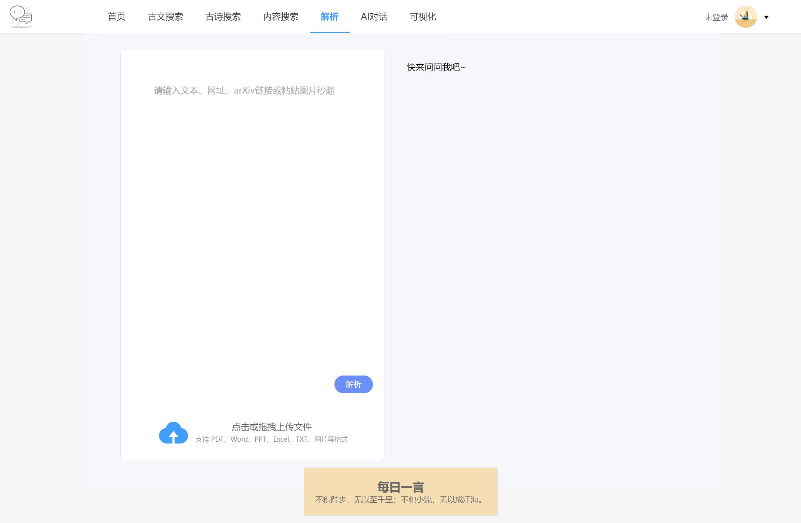
Core functions of the platform
AI dialogue page
The AI dialogue page mainly plans intelligent questions and answers, creation assistance, and interactive learning functions.

Slide 14
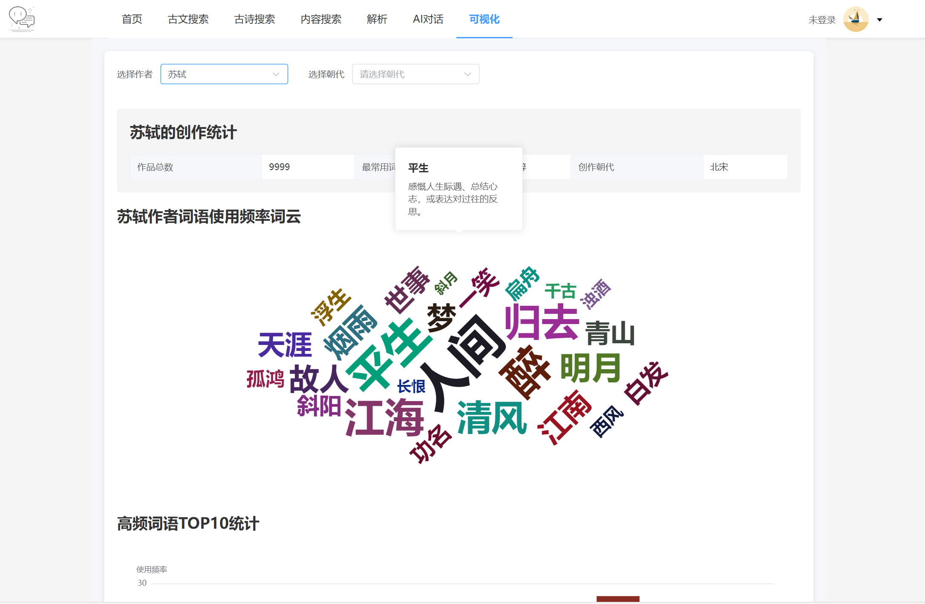
Core functions of the platform
Visualization page
On the visualization page, word clouds dynamically show an author's high-frequency words. The word cloud supports hover interaction, allowing you to view word connotations when hovering the mouse.

Slide 15
Characteristics of
WeChat mini-programs
PART THREE

Slide 16
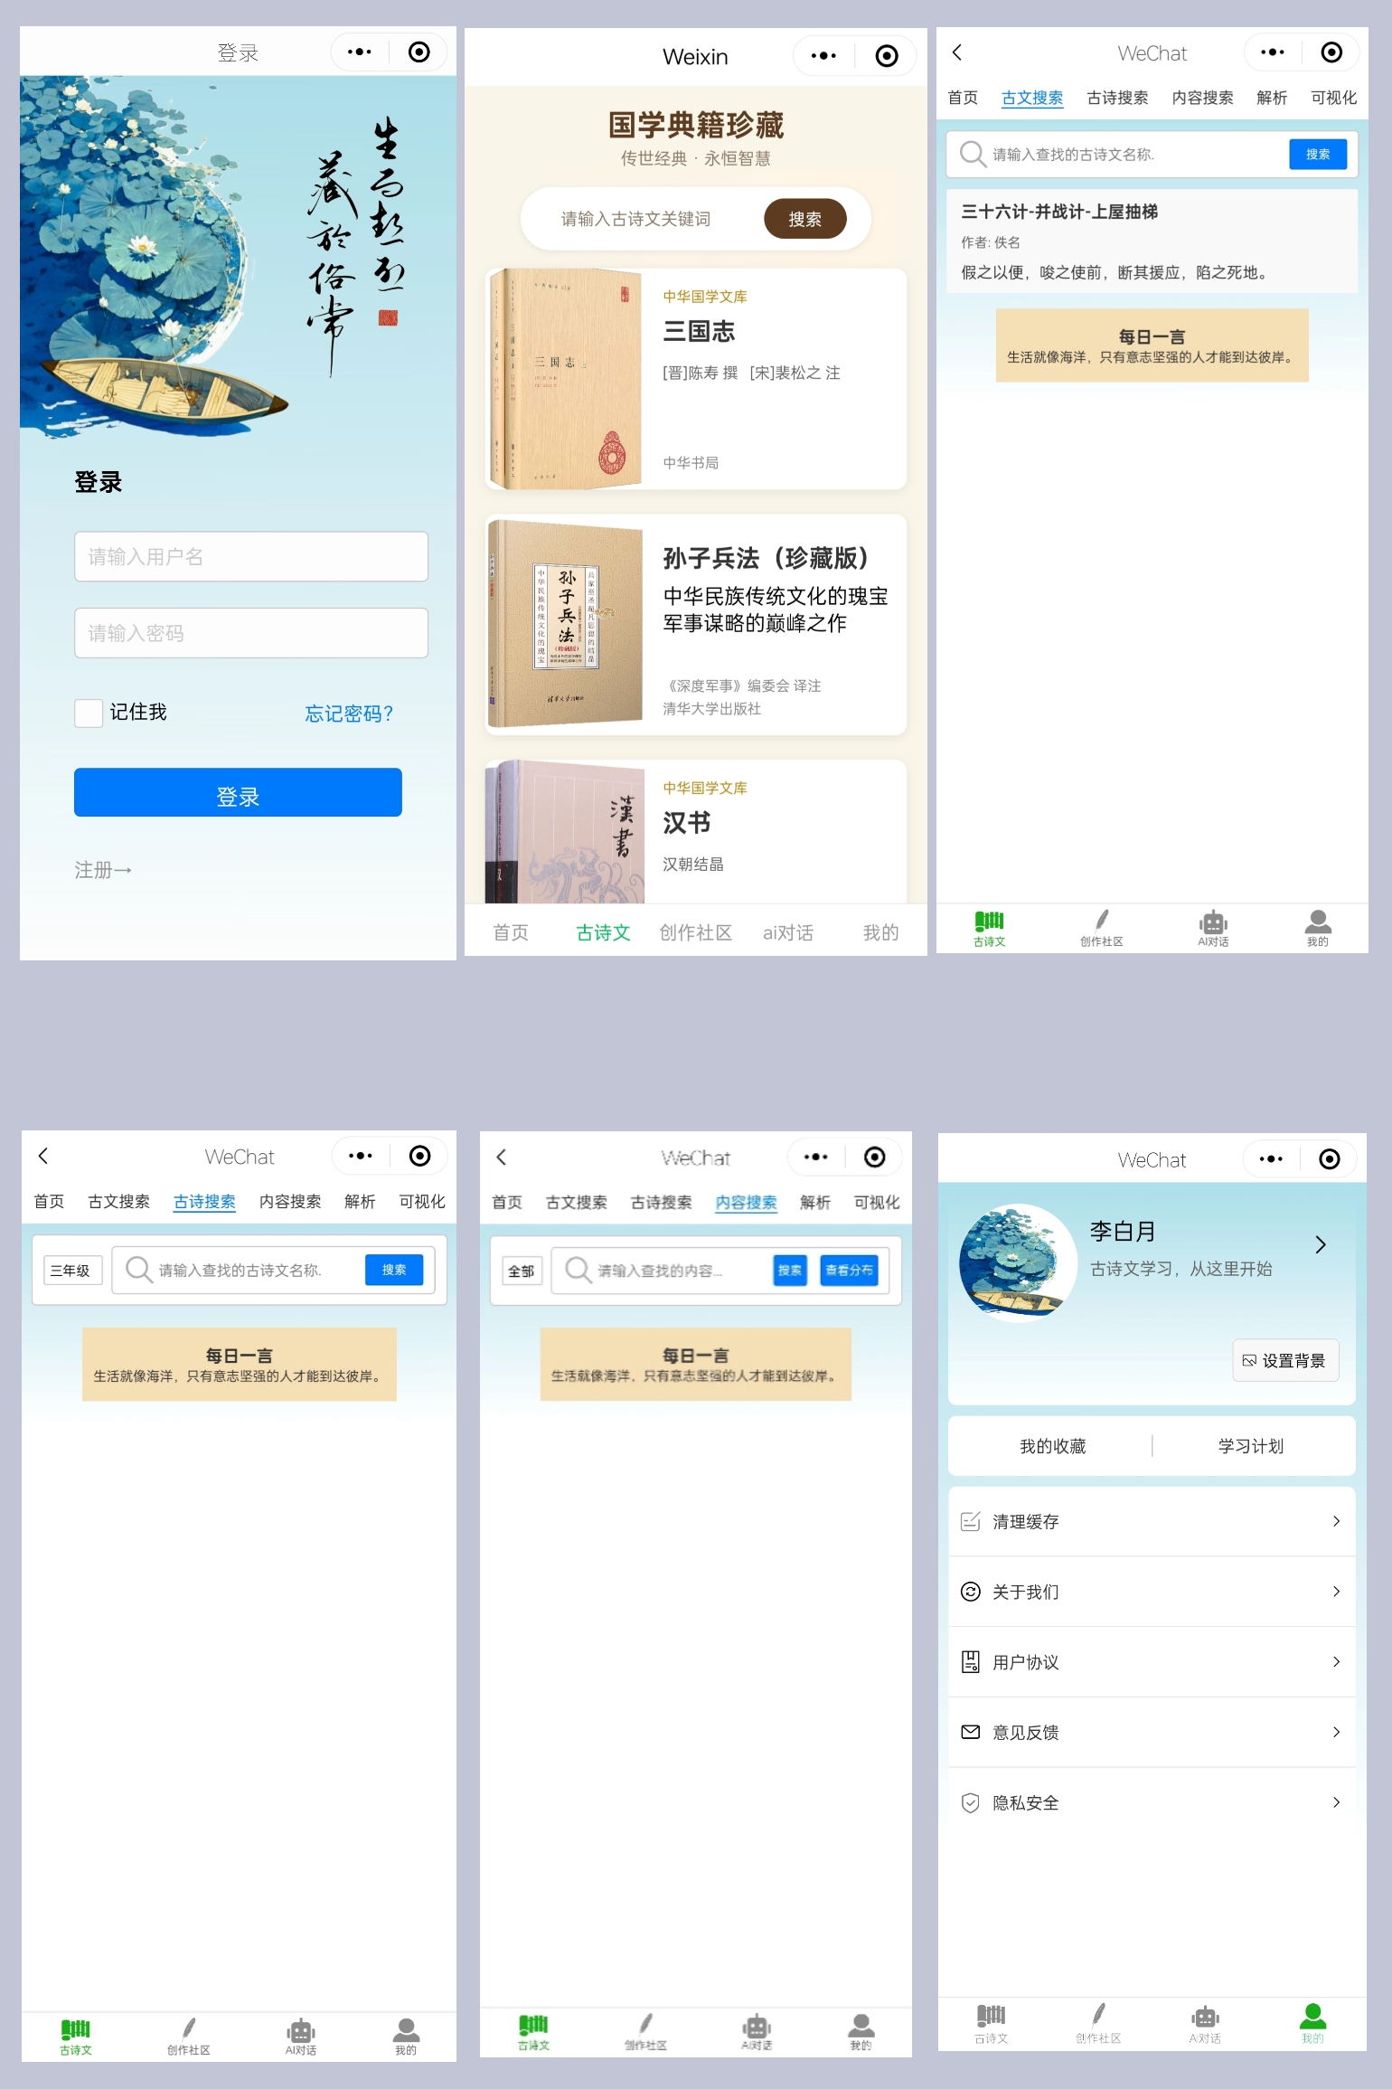
Characteristics of WeChat mini-programs
① Lightweight and convenient access;
② Supports voice input,
convenient for young users;
③ Social learning scenarios;
④ Learning progress synchronization;
⑤ Image lazy loading and interface reuse.

Slide 17
Development progress
and plan
PART FOUR

Slide 18
In progress task
development progress
1.Analyze author's commonly used words
statistically.
2.Optimize front-end interface interaction.
3.Develop WeChat mini-programs: complete
static page architecture and some function
docking.
4.Enrich the search results by integrating
polysemous words and dynasty information.

Slide 19
To be completed content
development progress
1.Develop a system to supports generating
matching exercises based on text features.
2.Build a smart ancient poem analysis engine
for imagery and good-sentence analysis.
3.Integrate text-to-image tech for poem
visualization.
4.Integrate the question bank of ancient
poetry and prose in the past years of
college entrance examination and high school
examination.
5.Set up memory progress tracking and
intelligent review reminders.

Slide 20
Plan
Short-term plan
Long-term plan
Continue to promote the improvement and optimization of basic functions, both on the platform and on the WeChat mini-program.
Keep enhancing product functionality, and explore commercialization for sustainable development.
Medium-term plan
Initially deploy and fine-tune the self-developed large model , and then optimize its functions and user experience based on feedback after the initial launch.

Slide 21
THANK YOU FOR LISTENING
Answering questions and exchanging ideas
Reporting person：WenZiyi

